Slide 1
Autotest CI Setup on Gitlab

Slide 2
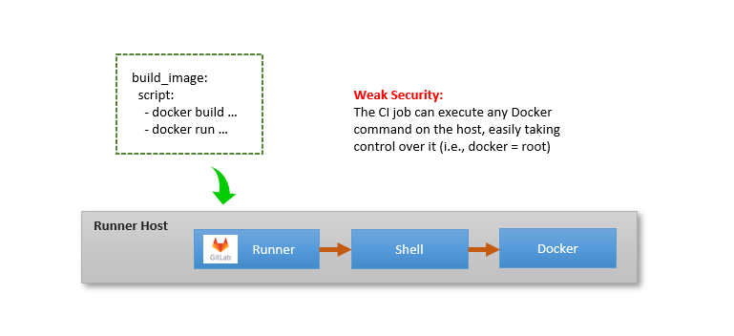
CI Executors
Executor Types:
Shell Executor
Docker Executor

Slide 3
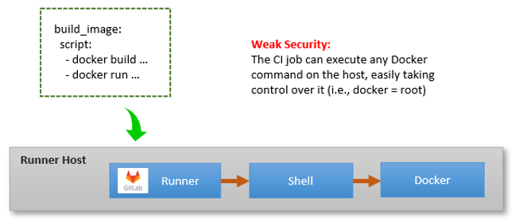
CI Executors -- Shell Executor
When using the shell executor, the CI job is composed of shell commands executed in the same context as the GitLab runner
The job executes within the GitLab runner’s host environment, which may or may not be clean
If the job needs to interact with Docker, the GitLab runner needs to be added to the docker group, which grants root level access to the job on the runner machine
CI script example:
Security issue example:
docker run --privileged -v /:/mnt alpine <risky-cmd>
build_job:
…
script:
- docker build . –f <docker-file> -t <docker-tag>
- docker run <docker-tag>

Slide 4
CI Executors -- Docker Executor
When using the docker executor, the CI job runs within one or more Docker containers.
This solves some problems of the shell executor, e.g we get a clean environment
If the CI job needs to interact with Docker itself, then the job needs access to a Docker engine (docker daemon)
2 ways:
DooD (Docker out of Docker)
DinD (Docker in Docker)

Slide 5
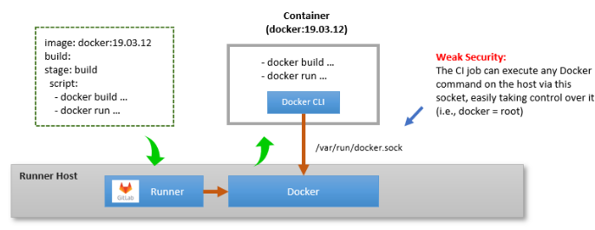
CI Executors -- Docker Executor (DooD)
DooD (Docker out of Docker)
-- Binding the host Docker Socket into the Job Container.
The docker daemon is running on the host.
The docker container access the host’s docker daemon via a bind-mount of /var/run/docker.sock
Gitlab runner config example:
[[runners]]
url = "https://gitlab.com/"
token = REGISTRATION_TOKEN
executor = "docker"
[runners.docker]
tls_verify = false
image = "docker:19.03.12"
privileged = false
disable_cache = false
volumes =["/var/run/docker.sock:/var/run/docker.sock", "/cache"]
CI script example:
build_job:
image: docker:19.03.12
stage: build
script:
- docker build . –f <docker-file> -t <docker-tag>
- docker run <docker-tag>

Slide 6
CI Executors -- Docker Executor (DooD)
Experiment
Run a docker container (test-a) binding /var/run/docker.sock on host.
Run a sub-docker container (test-b) in A, with volume map “-v /:/mnt”
The result shows test-b can access and operate / on host
[container test-a]
[container test-b]
docker run -it –name test-b -v /:/mnt docker sh
/ # ls /mnt/flag*
/ # touch /mnt/test.stub
yxxie@commqa_des09:~$ sudo touch /flag_host
yxxie@commqa_des09:~$ docker run -it --rm -v /var/run/docker.sock:/var/run/docker.sock docker sh
/ #
/ # touch /flag_dockerA
/ # docker run -it --rm -v /:/mnt docker sh
/ # ls /mnt/flag*
/mnt/flag_host
/ # touch /mnt/test.stub
## in host shell
yxxie@commqa_des09:~$ ls /test*
/test.stub
/mnt
Docker Client
docker run -it –name test-a -v /var/run/docker.sock:/var/run/docker.sock docker sh
(/var/run/docker.socket)
Runner host
Runner
Docker Engine
/
/flag_host
/test.stub

Slide 7
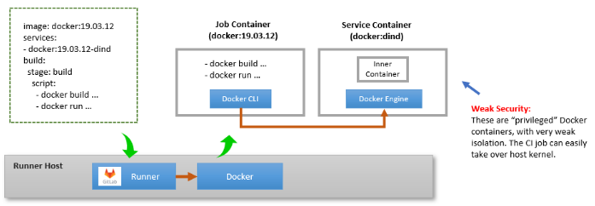
CI Executors -- Docker Executor (DinD)
DinD (Docker in Docker)
-- Job container runs alongside with the dind service container.
The dind service container contains the Docker engine
The CI job (‘docker’ container) contains docker client in this case.
Gitlab runner config example:
[[runners]]
url = "https://gitlab.com/"
token = REGISTRATION_TOKEN
executor = "docker"
[runners.docker]
tls_verify = true
image = "docker:19.03.12"
privileged = true
# required for service container to run docker engine
disable_cache = false
volumes =["/certs/client", "/cache"]
# /certs/client enables job/service container to share docker TLS credential
CI script example:
image: docker:19.03.12
Service:
- docker:dind
build_job:
stage: build
script:
- docker build . –f <docker-file> -t <docker-tag>
- docker run <docker-tag>
Notes:
dockerd | Docker Documentation

Slide 8
CI Executors – DinD Experiment 1
Tips for running DinD
privileged = true
without it, the dockerd daemon in dind will not start
Set DOCKER_HOST to make docker use dind service
e.g
export DOCKER_HOST=tcp://docker:2375 # with TLS
export DOCKER_HOST=tcp://<dind service ip>:2376 # w/o TLS
Config TLS
TLS can be turned off – set DOCKER_TLS_CERTDIR to "“, otherwise set the dir. e.g.
DOCKER_TLS_CERTDIR: /certs
DOCKER_CERT_PATH: /certs/client
If using TLS, then the certificates created by docker:dind need to be shared between the dind service and runner containers – by mounting the “/certs/client” inside dind to the job container
Experiment:
# run docker:dind
yxxie@commqa_des09:~/tmp$ docker run --name dind -td --rm --privileged --network test --ip 10.20.30.111 -v /certs/client:/certs/client docker:dind
# run a “runner container” from host without mapping /certs/client
yxxie@commqa_des09:~$ docker run -it --rm --network test docker sh
/ # export DOCKER_HOST=tcp://10.20.30.111:2376
/ # docker ps
Error response from daemon: Client sent an HTTP request to an HTTPS server.
# run a “runner container” from host with mapping /certs/client
yxxie@commqa_des09:~/tmp$ docker run -it --rm --name runner -v /certs/client:/certs/client -e DOCKER_HOST=tcp://10.20.30.111:2376 --network test docker sh
/ # docker ps
CONTAINER ID IMAGE COMMAND CREATED STATUS PORTS NAMES
/ # docker run -id --name alpine-in-docker alpine
/ # docker ps
CONTAINER ID IMAGE COMMAND CREATED STATUS PORTS NAMES
2e0b0d43cf95 alpine "/bin/sh" 44 seconds ago Up 43 seconds alpine-in-docker
The gitlab runner docker config example for dind TLS:
[[runners]]
url = "https://gitlab.com/"
token = REGISTRATION_TOKEN
executor = "docker"
[runners.docker]
tls_verify = true
privileged = true
volumes =["/certs/client", "/cache"]
Notes:
# Example of using DinD engine directly from host
yxxie@commqa_des09:~$ docker ps
CONTAINER ID IMAGE COMMAND CREATED STATUS PORTS NAMES
4649adb8eac7 docker "docker-entrypoint.s…" 4 hours ago Up 4 hours runner
6898b3c88ac5 docker:dind "dockerd-entrypoint.…" 7 hours ago Up 7 hours 2375-2376/tcp dind
ab551e57f625 oats_dvms:3.4.0.753_ATS-4 "/bin/sh -c /config_…" 13 hours ago Up 13 hours dvms-3.4.0.753_ATS-4-01
yxxie@commqa_des09:~$ docker inspect -f '{{range.NetworkSettings.Networks}}{{.IPAddress}}{{end}}' dind
172.17.0.4
yxxie@commqa_des09:~$ export DOCKER_HOST=tcp://172.17.0.4:2376; export DOCKER_TLS_VERIFY=1; export DOCKER_CERT_PATH=/certs/client;
yxxie@commqa_des09:~$ docker ps
CONTAINER ID IMAGE COMMAND CREATED STATUS PORTS NAMES
yxxie@commqa_des09:~$

Slide 9
CI Executors -- DinD Experiment 2
Experiment – simulate running autotest in Dind on local host
Test Setup (Logic View):
Run the autotest with 3 dockers (DVCS, TOOLS, PYTEST) in an ‘Autotest Job’ container which is spawned by the CI Runner. Logically, There are 3 layers of dockers
[Runner]
[DinD]
CI Host
docker run ... <autotest>
autotest
DOCKER_TLS_VERIFY=1
DOCKER_HOST=tcp://<dind>:2376
DOCKER_TLS_CERTDIR='/certs’
DOCKER_CERT_PATH=/certs/client
docker network create <test>
Runner (Container)
docker run ... <dvcs>
DVCS
bridge
Autotest Job (Container)
Build Job
docker run ... <tools>
TOOLS
DVCS
TOOLS
PYTEST
(These environment variables are used by docker client)
Other Job
docker run ... <pytest>
PYTEST
Test bridge
…
Docker Client
DOCKER_HOST=
tcp://<dind-ip>:2376
Docker Engine
/certs/client
/certs/client
Test Setup (Concrete View):
Spawn a “CI Runner” container on CI host.
Run a docker:dind (name as DinD) on CI host. Configure CI Runner’s docker client to use DinD ‘s docker engine
Spawn an “Autotest job” from the Runner container. (the concrete container is in DinD)
Spawn DVCS, TOOLS and PYTEST from “autotest” container. (the concrete containers are in DinD) and connect them to the same test bridge in DinD.
-v /certs/client:/certs/client
(/var/run/docker.socket)
CI Host
/certs/client
CI Bridge
Docker Engine
Notes:
[DinD] docker run --name dind -td --rm --privileged --network <ci bridge> --ip <dind-ip> -v /certs/client:/certs/client docker:dind
[Runner] docker run -it --rm --name runner -v /certs/client:/certs/client -e DOCKER_HOST=tcp://<dind-ip>:2376 --network <ci bridge> docker
[Autotest] docker run -it --name autotest -e DOCKER_HOST=tcp://<dind-ip>:2376 -e DOCKER_TLS_VERIFY=1 -e DOCKER_CERT_PATH=/certs/client -v /certs/client:/certs/client docker
[DVCS] docker run --name autotest_dvcs -id --network=test -v $CI_PROJECT_DIR/reports:/reports autotest-dvcs-docker:latest;
export AUTOTEST_DVCS_DOCKER_IP=$(docker inspect -f '{{range.NetworkSettings.Networks}}{{.IPAddress}}{{end}}' autotest_dvcs)
[TOOLS] docker run --name autotest_tools -id --network=test -e AUTOTEST_DVCS_DOCKER_IP=$AUTOTEST_DVCS_DOCKER_IP -v $CI_PROJECT_DIR/reports:/reports $AUTOTEST_TOOLS_DOCKER
export AUTOTEST_TOOLS_DOCKER_IP=$(docker inspect -f '{{range.NetworkSettings.Networks}}{{.IPAddress}}{{end}}' autotest_tools)
[PYTEST] docker run --name autotest_pytest -it --network="test" -e AUTOTEST_DVCS_DOCKER_IP=$AUTOTEST_DVCS_DOCKER_IP -e AUTOTEST_TOOLS_DOCKER_IP=$AUTOTEST_TOOLS_DOCKER_IP -v $CI_PROJECT_DIR/reports:/reports $AUTOTEST_PYTEST_DOCKER bash -c "/scripts/gen_autotest_config.sh $AUTOTEST_DVCS_DOCKER_IP $AUTOTEST_TOOLS_DOCKER_IP $AUTOTEST_TOOLS_DOCKER_IP > /autotest/inputs/autotest_config.json ; pytest --config='/autotest/inputs/autotest_config.json' --skip_xfail_tests --junitxml='/reports/junit_pytest.xml' tests/DVCS/msml/test_play.py“
A reference picture: dind-gitlab-ci-runner.png (695×347) (andrewmunsell.com)

Slide 10
Docker Network
Host
Bridge

Slide 11
Docker:dind Service
The docker:dind image is required because it starts up the docker daemon when it is brought up by a runner.
The docker cli can exist on a host/container without having the daemon running and can be pointed to control a daemon running somewhere else.
build_job:
image: docker:latest
services:
- docker:dind
…
script:
docker build …
docker run …
Notes:
Ref: Securing GitLab CI pipelines with Sysbox | Nestybox Blog Site

Slide 12
Docker Network

Slide 13
Create a network for each job
Use a new user-defined Docker bridge network for each job.
When a job starts, a bridge network is created (similar to docker network create <network>). Upon creation, the service containers and the build job container are connected to this network.
The network is removed at the end of the job.
To enable this mode you must enable the FF_NETWORK_PER_BUILD feature flag
Notes:
uses a new user-defined Docker bridge network for each job

